Slide 1

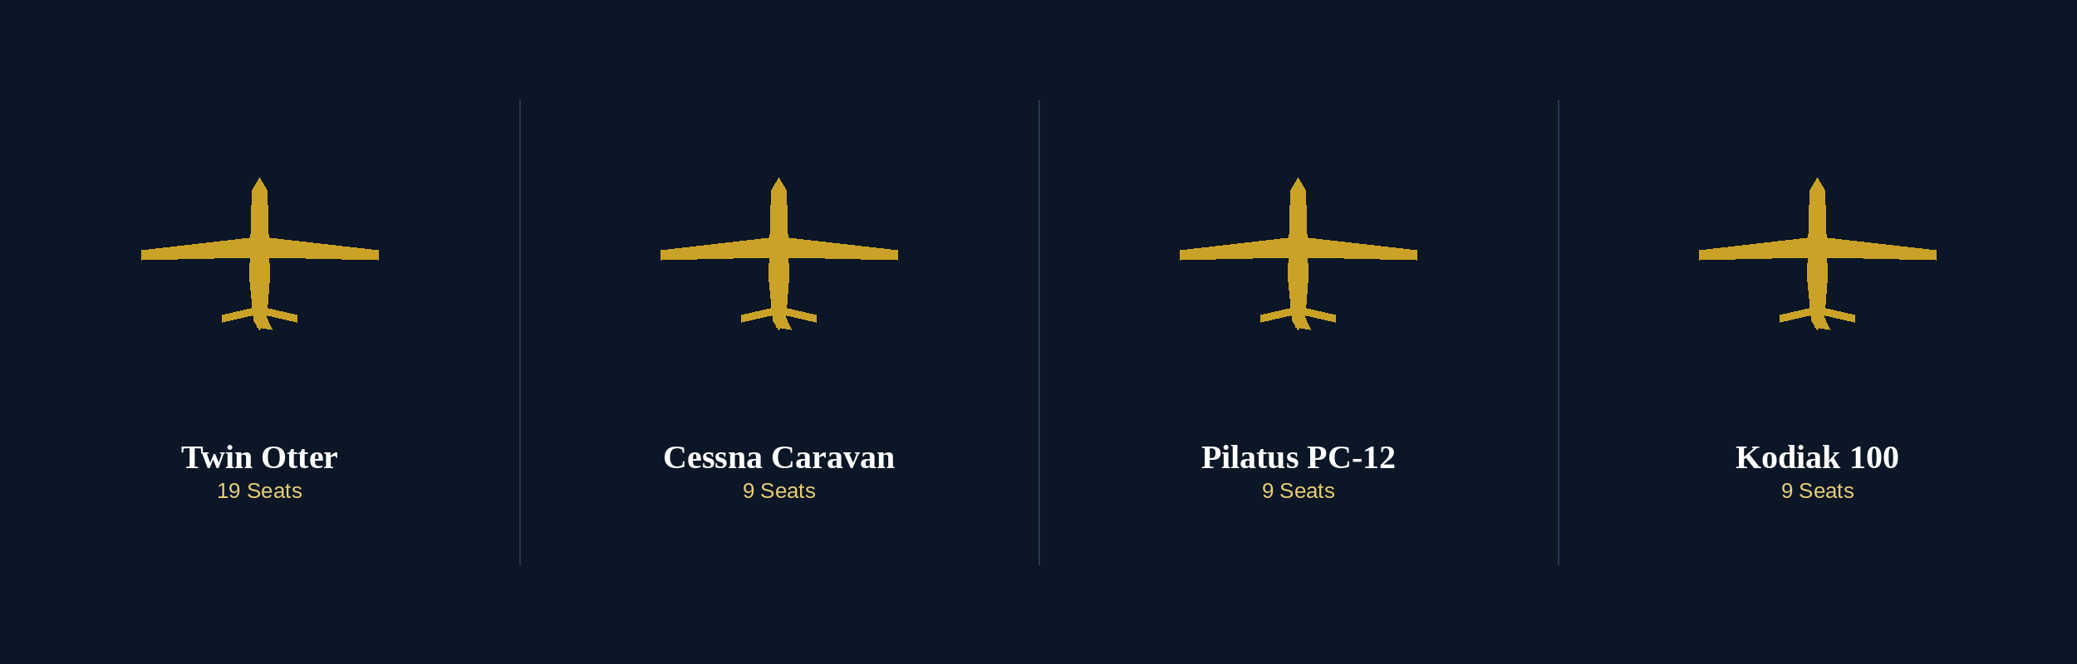
ZIPLINE EXPRESS
AIRCRAFT LEASING & FINANCING SUMMARY
LTD.
Building the Next Generation of Regional Air
Transportation Across The Bahamas
Captain Mornel Brown
Founder & CEO
Martin Weber
Strategic Advisor
AUGUST 2026

Slide 2
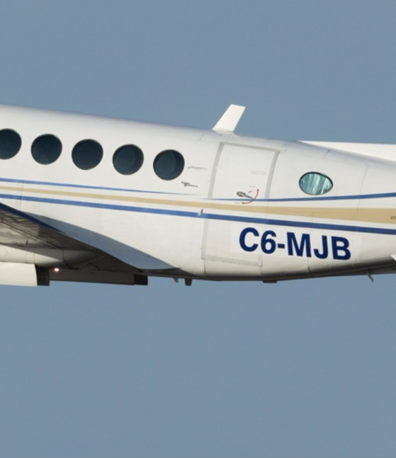
BUILDING TRUST SINCE 2017
An Established Airline Built on
Safety, Reliability and Trust
Zipline Express was founded with a simple philosophy: provide safe, dependable air transportation that connects the islands of The Bahamas while treating every passenger as if they were family.
Since 2017, the Company has grown from a single-aircraft charter operator into an established Bahamian commercial aviation company serving residents, businesses, visitors and government agencies throughout the archipelago.
Rather than pursuing rapid expansion, Zipline has focused on disciplined growth — investing in experienced people, maintaining the highest operational standards, and building long-term customer relationships.
“Our mission has never been simply to fly people from one island to another. It has always been to earn their trust every time they step aboard one of our aircraft.”
— Captain Mornel Brown, Founder & CEO
ZIPLINE EXPRESS · CONFIDENTIAL · 02

Slide 3
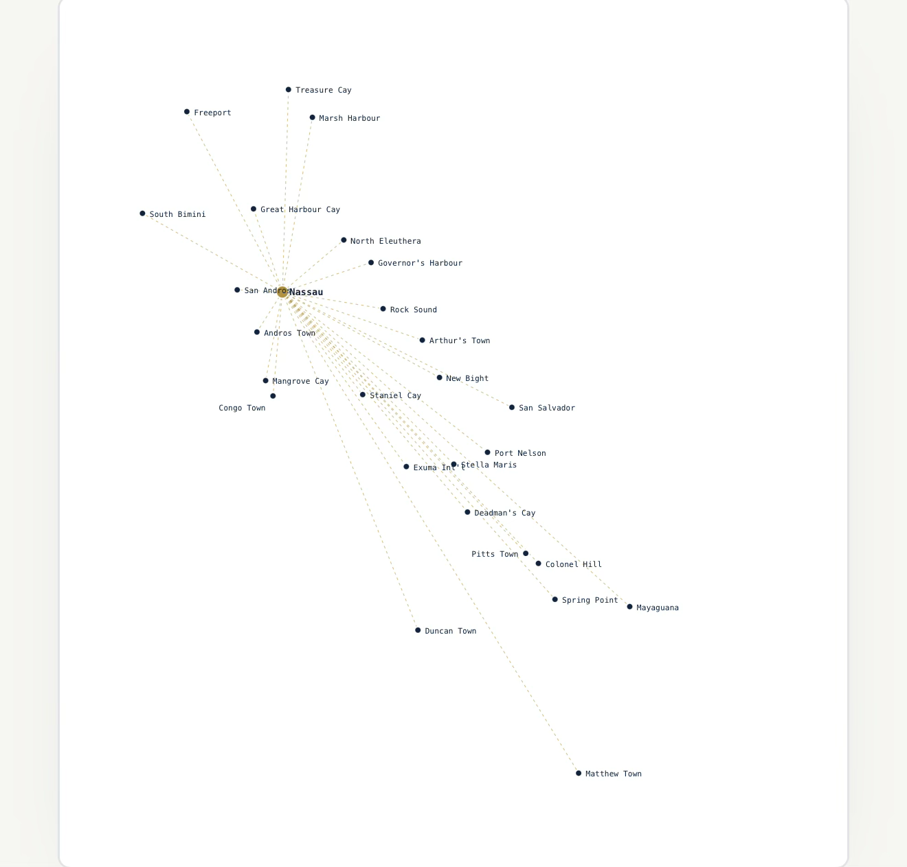
THE OPPORTUNITY
A Rare Opportunity
The Bahamian aviation market is undergoing one of its most significant transitions in decades. Recent changes among regional operators have created an opportunity to restore scheduled passenger service on routes that remain vital to residents, businesses and visitors.
Communities still require dependable air transportation.
Tourism continues to grow.
Businesses still depend on reliable regional connectivity.
The need has not disappeared. Only the available capacity has.
Zipline Express is uniquely positioned to respond.
• Established operating history
• Existing commercial operations
• Experienced management
• Government operating approvals
• Existing maintenance relationships
• Proven financial discipline
ZIPLINE EXPRESS · CONFIDENTIAL · 03

Slide 4
WHY ZIPLINE
Built on a Proven Foundation
ESTABLISHED
PROVEN
EXPERIENCED
2017
32,400+
20,000+
Operating since
Passengers transported
Combined senior pilot hours
TRUSTED
SAFE
GROWING
2,700
Maintenance-First
Scheduled Service
Operating philosophy
Expanding into regional passenger service
Commercial charter flights completed
Building upon a proven foundation rather than starting from scratch.
ZIPLINE EXPRESS · CONFIDENTIAL · 04

Slide 5
LEADERSHIP
Leadership
MB
Captain Mornel Brown
CHIEF PILOT
FOUNDER & CHIEF EXECUTIVE OFFICER
Captain Hensel Bullard
9,500+ flight hours · 16+ years of aviation experience
10,500+
flight hours
Captain Mornel Brown has dedicated his career to building a professional, safety-focused airline serving the people of The Bahamas. He has guided Zipline Express from a single-aircraft operation into a respected commercial operator known for reliability, professionalism and customer service.
30+
years of commercial aviation experience
His operational leadership strengthens Zipline’s commitment to training, standardization and operational excellence.
Build carefully. Operate safely. Deliver consistently.
— Captain Brown’s leadership philosophy
20,000+ combined flight hours. Together, Zipline’s senior flight leadership provides exceptional operational experience and continuity.
ZIPLINE EXPRESS · CONFIDENTIAL · 05

Slide 6
OUR JOURNEY
Building an Airline
2017
2019
2023
2026
FUTURE
Zipline Express Founded
Cessna 402 Introduced
King Air 100 Added
New Aircraft Acquisition
Scheduled Regional Airline
Commercial financing successfully serviced
Commercial financing successfully serviced
Twin Otter · Caravan · PC-12 · Kodiak
Disciplined growth. Proven execution. Long-term vision.
ZIPLINE EXPRESS · CONFIDENTIAL · 06

Slide 7
OUR NETWORK
Connecting The Bahamas
For nearly a decade, Zipline Express has connected communities throughout The Bahamas through reliable charter operations — building the operational experience, market knowledge and customer relationships that support the Company's planned expansion into scheduled passenger service.
32,400+
PASSENGERS
2,700
COMMERCIAL FLIGHTS
2017
SERVING THE BAHAMAS
ZIPLINE EXPRESS · CONFIDENTIAL · 07

Slide 8
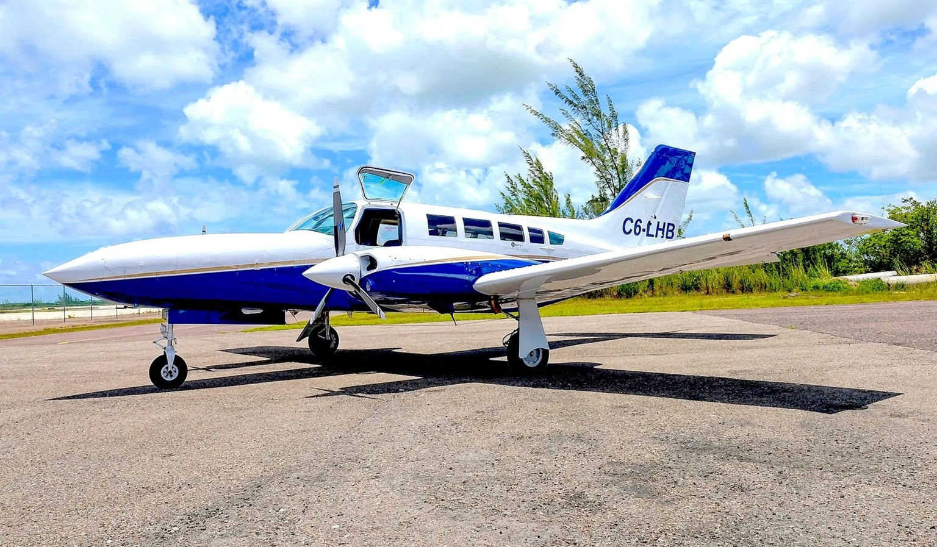
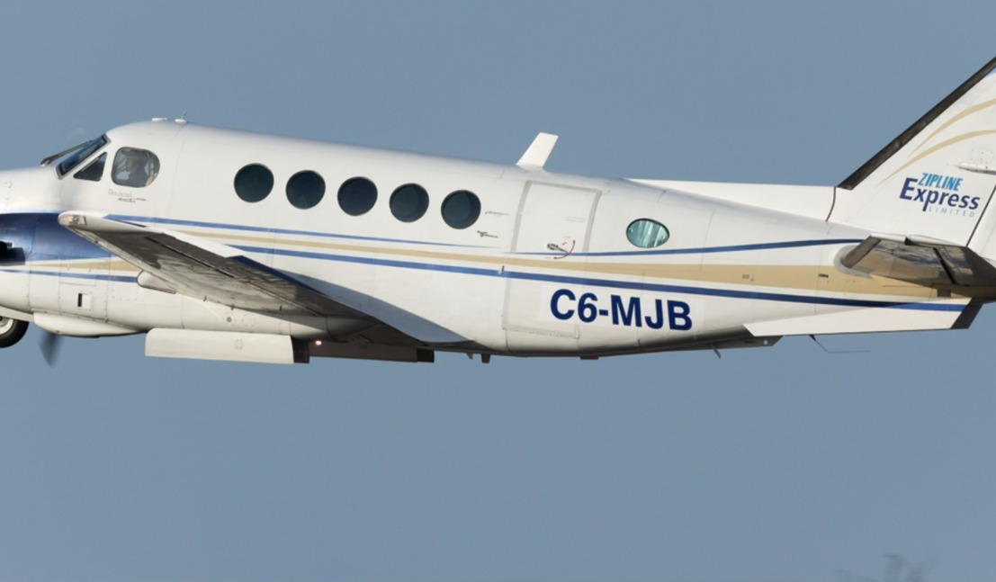
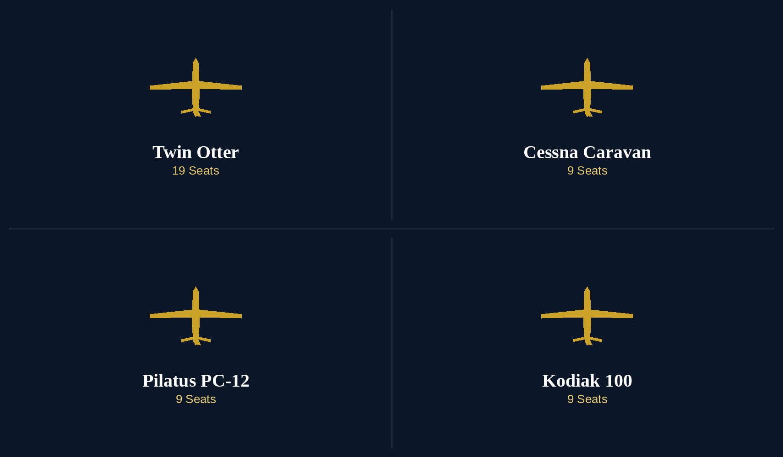
OUR FLEET
Building Our Fleet
WHERE WE STARTED
WHERE WE ARE TODAY
WHERE WE'RE GOING
Cessna 402
King Air 100
Next-Generation Fleet
The aircraft that established Zipline's reputation for dependable inter-island charter service.
Expanded capability. Greater range. Greater comfort. Greater flexibility.
Evaluating the Twin Otter, Cessna Caravan, Pilatus PC-12 and Kodiak to power scheduled regional service.
ZIPLINE EXPRESS · CONFIDENTIAL · 08

Slide 9
AIRCRAFT FINANCING
Seeking Leasing & Financing Partners
Zipline Express is inviting proposals from aircraft leasing and financing companies to support the acquisition of new aircraft for scheduled regional service.
AIRCRAFT UNDER CONSIDERATION
Twin Otter
Cessna Caravan
Pilatus PC-12
Kodiak 100
19 Seats
9 Seats
9 Seats
9 Seats
WHAT WE ARE SEEKING
WHY ZIPLINE
Dry lease arrangements — aircraft only. Zipline supplies crew, maintenance and operating insurance under its own Bahamas Air Transport Licence.
Established Bahamian operator since 2017, holding a current Air Transport Licence
Also open to aircraft financing or loan structures as an alternative to a dry lease.
32,400+ passengers carried, 2,700+ commercial flights completed
One or more aircraft from the types above, with flexible short- or medium-term lease terms.
Committed scheduled route network already identified (Freeport – Marsh Harbour, Freeport – Bimini)
Option to extend, renew or purchase at the end of the initial term.
Approximately $500,000 of Zipline's own capital already committed to this initiative
ZIPLINE EXPRESS · CONFIDENTIAL · 09

Slide 10
CAPITAL COMMITMENT
Zipline's Own Capital Commitment
Zipline Express is not seeking full financing. The Company has committed its own resources to this initiative, and is seeking a leasing or financing partner for the aircraft itself.
WHAT THIS DEMONSTRATES
APPROXIMATE CAPITAL AVAILABLE
$500,000
Committed Capital, Not Just a Plan
Zipline has already set aside its own funds — this is not a request to fund 100% of the initiative from an external source.
From Zipline Express's own resources
Reduced Counterparty Risk
A lessor or financier is not the sole source of capital behind this expansion; the Company shares the financial commitment.
This capital is available to support security deposits, initial lease payments, crew training, insurance deposits and working capital reserves — independent of, and in addition to, any lease or financing arrangement for the aircraft itself.
Operational Readiness
These funds support the practical steps of entry into service — training, insurance, working capital — alongside the leased or financed aircraft.
ZIPLINE EXPRESS · CONFIDENTIAL · 10

Slide 11
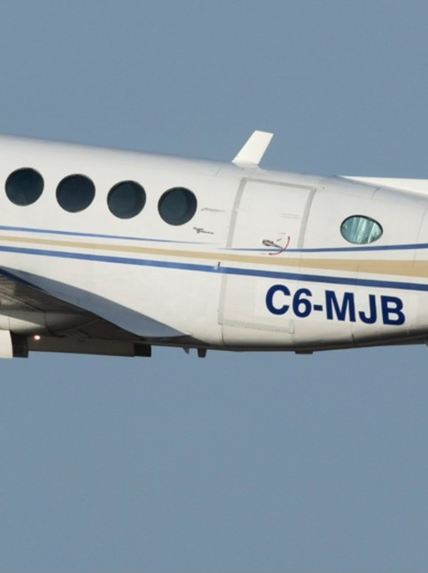
SAFETY & OPERATIONS
Safety & Operational
Excellence
Safety is the foundation of Zipline Express.
Our aircraft are maintained in accordance with manufacturer maintenance requirements by GES Aviation, our experienced Nassau-based maintenance provider.
Our pilots bring decades of commercial aviation experience across the fleet.
Our operational procedures emphasize professionalism, regulatory compliance and continuous improvement.
Every investment we make ultimately supports one objective: providing safe, reliable transportation for every passenger on every flight.
ZIPLINE EXPRESS · CONFIDENTIAL · 12

Slide 12
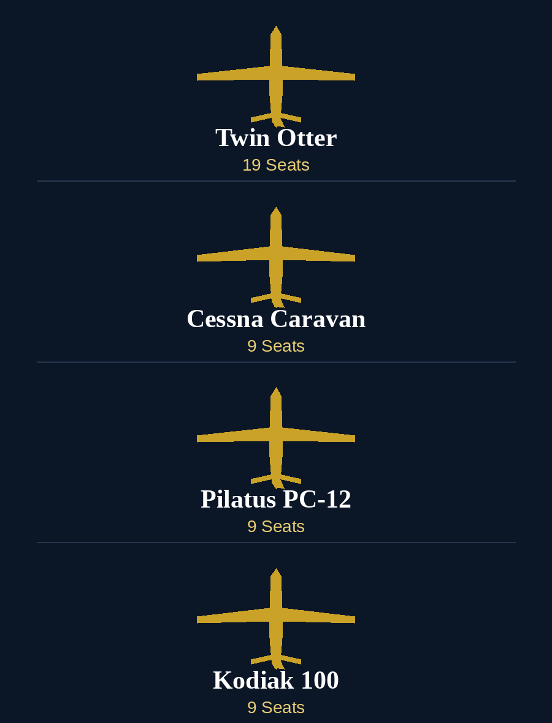
Looking Forward
Building the Next Generation of Regional
Air Transportation Across The Bahamas
The planned acquisition of new aircraft represents more than fleet expansion. It represents Zipline Express' commitment to strengthening regional connectivity, supporting tourism, serving local communities and building a sustainable airline for the future.
We invite you to join us as we write the next chapter in Bahamian regional aviation.
Captain Mornel Brown
Founder & Chief Executive Officer, Zipline Express Ltd.
ZIPLINE EXPRESS · CONFIDENTIAL · 13

